Slide 1
ELEMENTARY STATISTICS, BLUMAN
Central Limit Theorem Example 1
© 2019 McGraw-Hill Education. All rights reserved. Authorized only for instructor use in the classroom. No reproduction or further distribution permitted without the prior written consent of McGraw-Hill Education.

Slide 2
Objectives for this PowerPoint
Calculate a probability associated with a sample using the Central Limit Theorem

Slide 3
Problem
According to the The National Center for Biotechnology Information, the average age of Americans when Alzheimer’s disease is first diagnosed is 74.7 years. Assume that the population standard deviation is 8.6 years. If a random sample of 35 patients who have been diagnosed with Alzheimer’s disease is selected, what is the probability that the mean age of the sample is greater than 71 years?

Slide 4
What Question is Asked?
We must pay particular attention to the exact question that is being asked. We are not asked to find a probability associated with a single value rather we are asked to find a probability associated with a sample size of 35. In order to answer this question, we must first understand the Central Limit Theorem.

Slide 5
Central Limit Theorem
The Central Limit Theorem states that as the sample size increases without limit the shape of the distribution of the sample means will approach a normal distribution.
It is important to remember two things when using the Central Limit Theorem.
If Population normally distributed then Sampling distribution normally distributed regardless of sample size.
If Population not normally distributed then Sampling distribution is approximately normally distributed if sample size is at least 30.

Slide 6

Find the z Score (1)
The sample size for this problem is 35 so we will use the normal distribution to find this probability.
The question is asking us to find the probability that the sample mean is greater than 71 for the sample of 35 patients.
$$P\left(\overline{x}>71\right)$$
We will use a z score to find this probability.
$$z=\frac{\overline{x}−μ}{σ_{\overline{x}}}$$

Slide 7

Find the z Score (2)
It is very important that we use the standard deviation for the sampling distribution also called the standard error of the means when calculating a z score associated with a mean of a sample.
The standard deviation for the sampling distribution is found by dividing the standard deviation for the population by the square root of the sample size.
$$z=\frac{\overline{x}−μ}{\frac{σ}{n}}$$

Slide 8

Find the z Score (3)
So we will substitute the sample mean, population mean, standard deviation, and sample size into the z score formula.
$$z=\frac{\overline{x}−μ}{\frac{σ}{n}}$$
$$z=\frac{\overline{71}−74.7}{\frac{8.6}{\sqrt{35}}}=−2.55$$
$P\left(\overline{x}>71\right)$ is the same as P(z > -2.55)

Slide 9
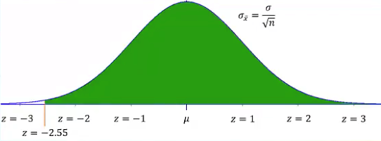
Probability Under the Curve
It is always helpful to draw an appropriately shaded curve when finding probabilities associated with a normal distribution.
Our z score of -2.55 will be between z = -3 and z = -2.
We are to find the probability that the z score for the sample mean would exceed -2.55. We will shade the region to the right of z = -2.55.

Slide 10
Use Table or Calculator to Find Probability
Use a tool such as a normal probability table or a graphing calculator to find probability.
We would find that the proportion of the distribution occupied by that shaded area is 0.9946.
The probability that the z score would be greater than -2.55 is 0.9946.
Another way to state this result is by saying 99.46% of all samples of size 35 among people diagnosed with Alzheimer’s disease would have an average age of diagnosis that is greater than 71 years.

Slide 11
Summary
In this PowerPoint, we learned how to calculate a probability associated with a sample using the central limit theorem.

